Slide 1


Intelligent Food Redistribution and Waste Reduction Network
SIMATS ENGINEERING
SAVEETHA INSTITUTE OF MEDICAL AND TECHNICAL SCIENCES
Presented by,
Faculty,
Dr. Magesh Kumar
Gadiputikotla Vyshnavi – 192425069
Mandem Nandhini-192472318
Mallike Reddy Jayasree- 192325140
Monika G- 192421158
Course : CSA0903- Programming in Java

Slide 2


ABSTRACT
Food waste and food insecurity are major challenges that require an efficient and sustainable redistribution system.
The proposed platform connects donors, NGOs, and volunteers to streamline the collection and distribution of extra food.
Built using Java Spring Boot and MySQL, the system provides secure user management and real-time food donation tracking.
Intelligent resource allocation helps ensure that donated food reaches the right recipients quickly and efficiently.
The platform aims to reduce food waste, improve food accessibility, and support sustainable community welfare.

Slide 3

INTRODUCTION
Food waste is a major problem, while many people still face food shortages.
Restaurants, supermarkets, and events often have extra food that gets wasted.
There is no efficient system to quickly connect food donors with NGOs and shelters.
This project provides a platform to collect, manage, and redistribute extra food efficiently.
It helps reduce food waste, supports people in need, and promotes sustainable food distribution.

Slide 4
OBJECTIVES
Objective | Explanation
Reduce Food Wastage | Minimize the disposal of extra food by enabling timely donations.
Connect Donors and NGOs | Provide a platform that links food donors with nearby NGOs and shelters.
Optimize Food Distribution | Ensure donated food is allocated efficiently to the right recipients.
Manage Volunteer Activities | Help volunteers accept, collect, and deliver food donations on time.
Promote Sustainable Food Sharing | Encourage responsible food redistribution to support communities and reduce waste.

Slide 5
LITERATURE SURVEY
S.No | Author | Paper Title | Methodology / Algorithm | Limitation
1 | Rahul Srinivas Sucharitha, Seokcheon Lee | Two-Stage Hybrid Demand Estimation via Clustering for Food Banks | Gaussian Mixture Model (GMM) and Clustering | Performance depends on quality of historical demand data.
2 | Reihaneh Ghoniem | A Multi-Start Optimization-Based Heuristic for a Food Bank Distribution Problem | Multi-start Heuristic and Neighborhood Search | No guarantee of global optimal solution.
3 | Nistha Dubey, Ajinkya Tanksale | Multi-Depot Vehicle Routing Problem with Time Windows, Split Pickup and Split Delivery for Surplus Food Recovery | Multi-Depot Vehicle Routing Problem (MDVRP) | High routing complexity for large transportation networks.
4 | Divya J. Nair, David Rey, Vinayak V. Dixit | Scheduling and Routing Models for Food Rescue and Delivery Operations | Vehicle Routing and Scheduling Optimization | Assumes static transportation conditions.
5 | Zheyuan Ryan Shi, Yiwen Yuan, Kimberly Lo, Leah Lizarondo, Fei Fang | Improving Efficiency of Volunteer-Based Food Rescue Operations | Reinforcement Learning with Volunteer Assignment | Requires sufficient volunteer activity data.

Slide 6
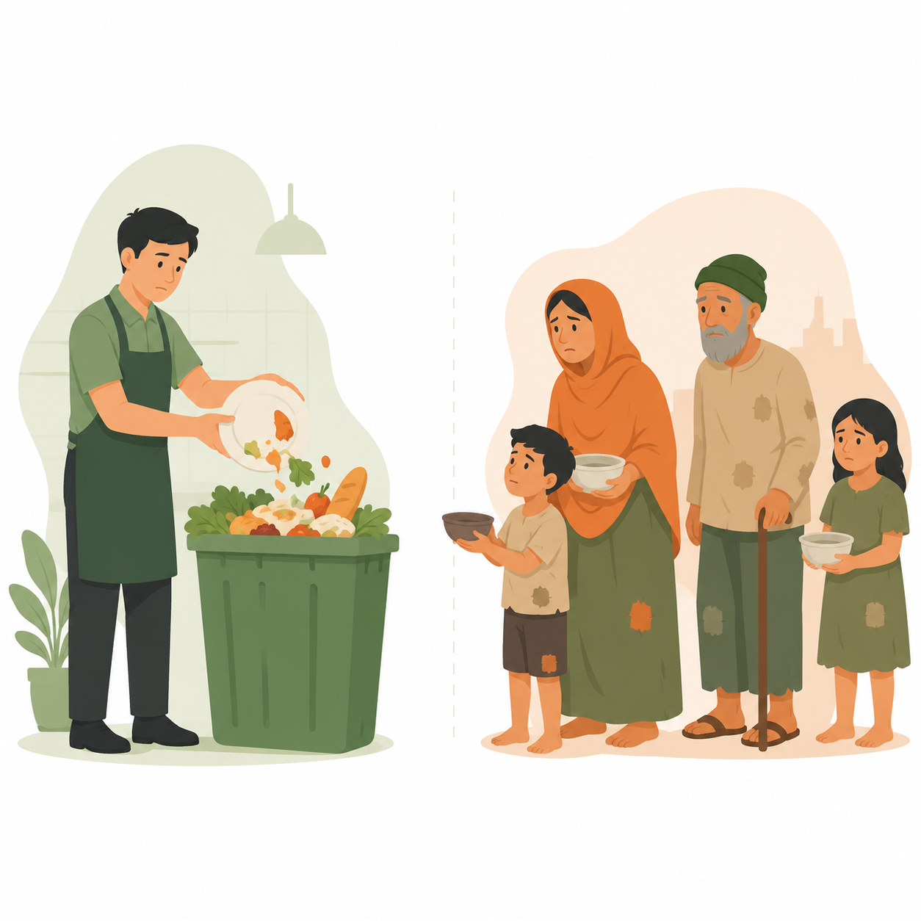
PROBLEM STATEMENT
Every day, a large amount of edible food is wasted while many people suffer from hunger.
There is no proper platform to connect food donors, NGOs, and volunteers efficiently.
Manual coordination causes delays, poor communication, and unnecessary food wastage.
An efficient system is needed to collect, manage, and redistribute surplus food to those in need.

Slide 7
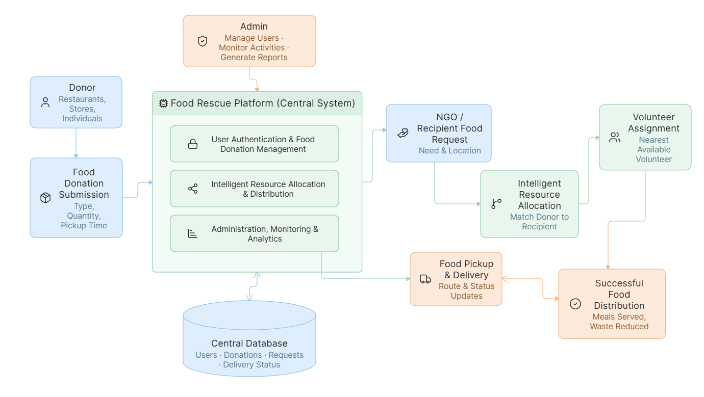
SYSTEM ARCHITECTURE

Slide 8

MODULE – 1
User & Food Donation Management
Purpose: To provide secure user access and efficiently manage food donation information within the platform.
Key Points:
User registration and secure login for different user roles.
Role-based access for Admin, Donor, NGO, and Volunteer.
Add, edit, and manage extra food donation details.
View and update the availability status of donated food.
Outcome: Provides secure user access and organized management of food donations.

Slide 9
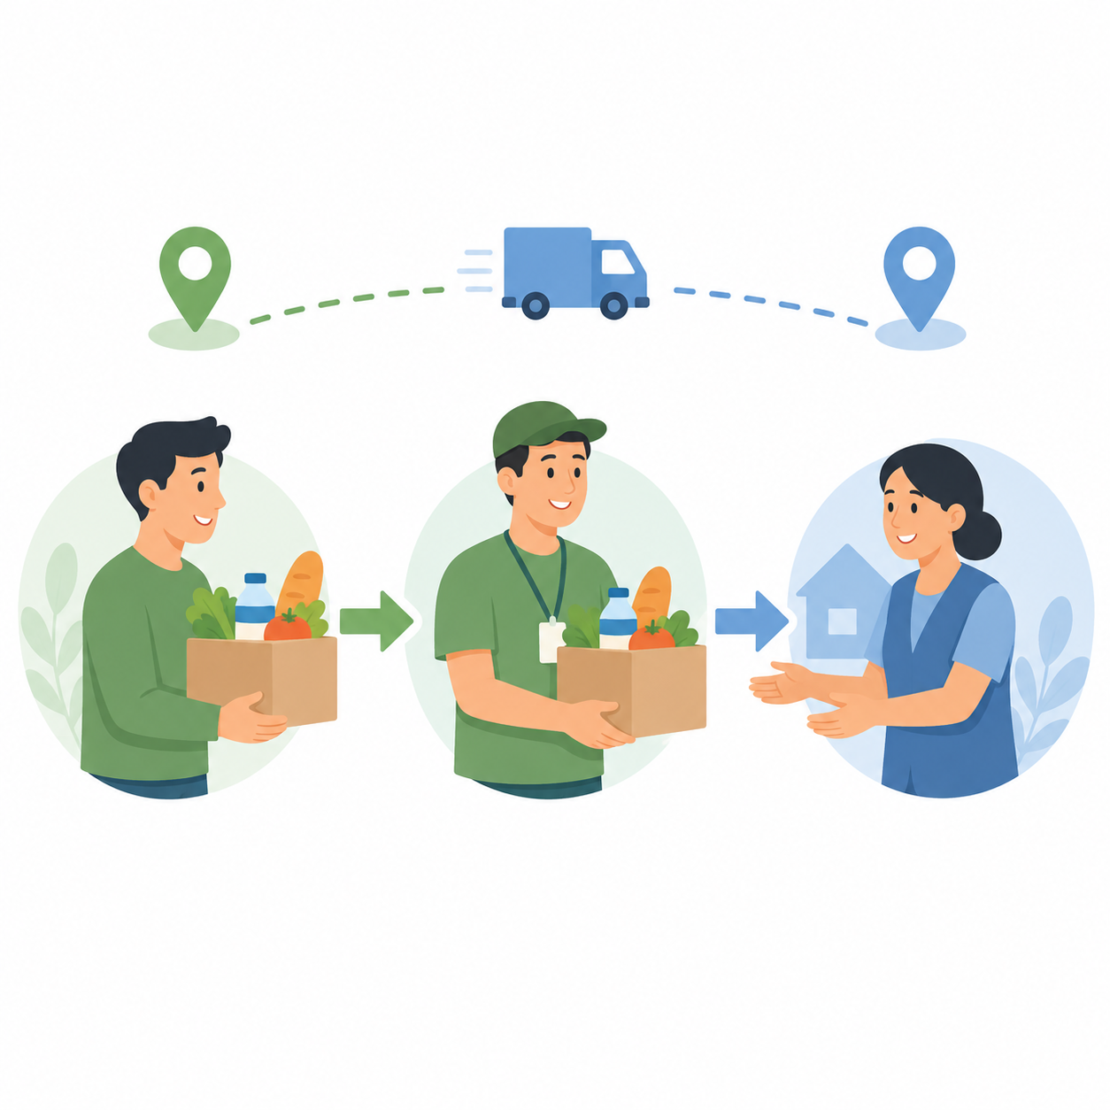
MODULE – 2
Intelligent Resource Allocation & Distribution
Purpose: To efficiently allocate donated food to NGOs and coordinate its delivery through volunteers.
Key Points:
NGOs can request available food donations.
Intelligent allocation based on food availability and requirements.
Assign volunteers for food pickup and delivery.
Track the delivery status of each donation.
Outcome: Ensures efficient food allocation and timely distribution to the right recipients.

Slide 10

MODULE – 3
Administration, Monitoring & Analytics
Purpose: To monitor system activities, manage users, and generate reports for efficient platform administration.
Key Points:
Manage users and food donation records.
Monitor donation and distribution activities.
Generate reports and platform statistics.
Maintain overall system performance and data.
Outcome: Provides centralized administration and effective monitoring of the entire platform.

Slide 11
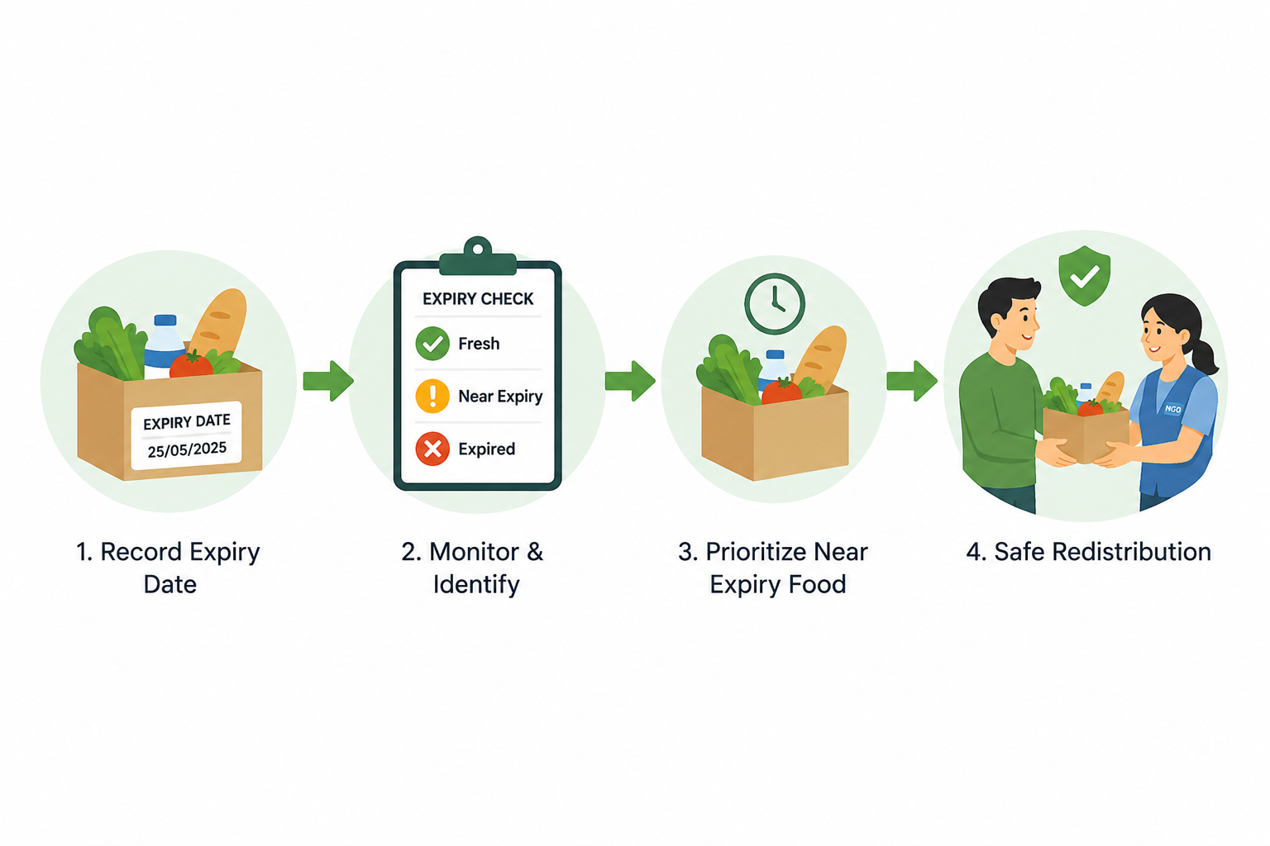
MODULE – 4
Food Safety & Expiry Management
Purpose: To monitor food safety and expiry details and ensure that only safe and consumable food is redistributed.
Key Points:
● Track food preparation and expiry date/time.
● Monitor the freshness and availability status of donated food.
● Identify and prioritize donations approaching expiry.
● Prevent expired food from being allocated for distribution.
Outcome: Ensures safe and timely redistribution of surplus food while reducing food spoilage and wastage.

Slide 12
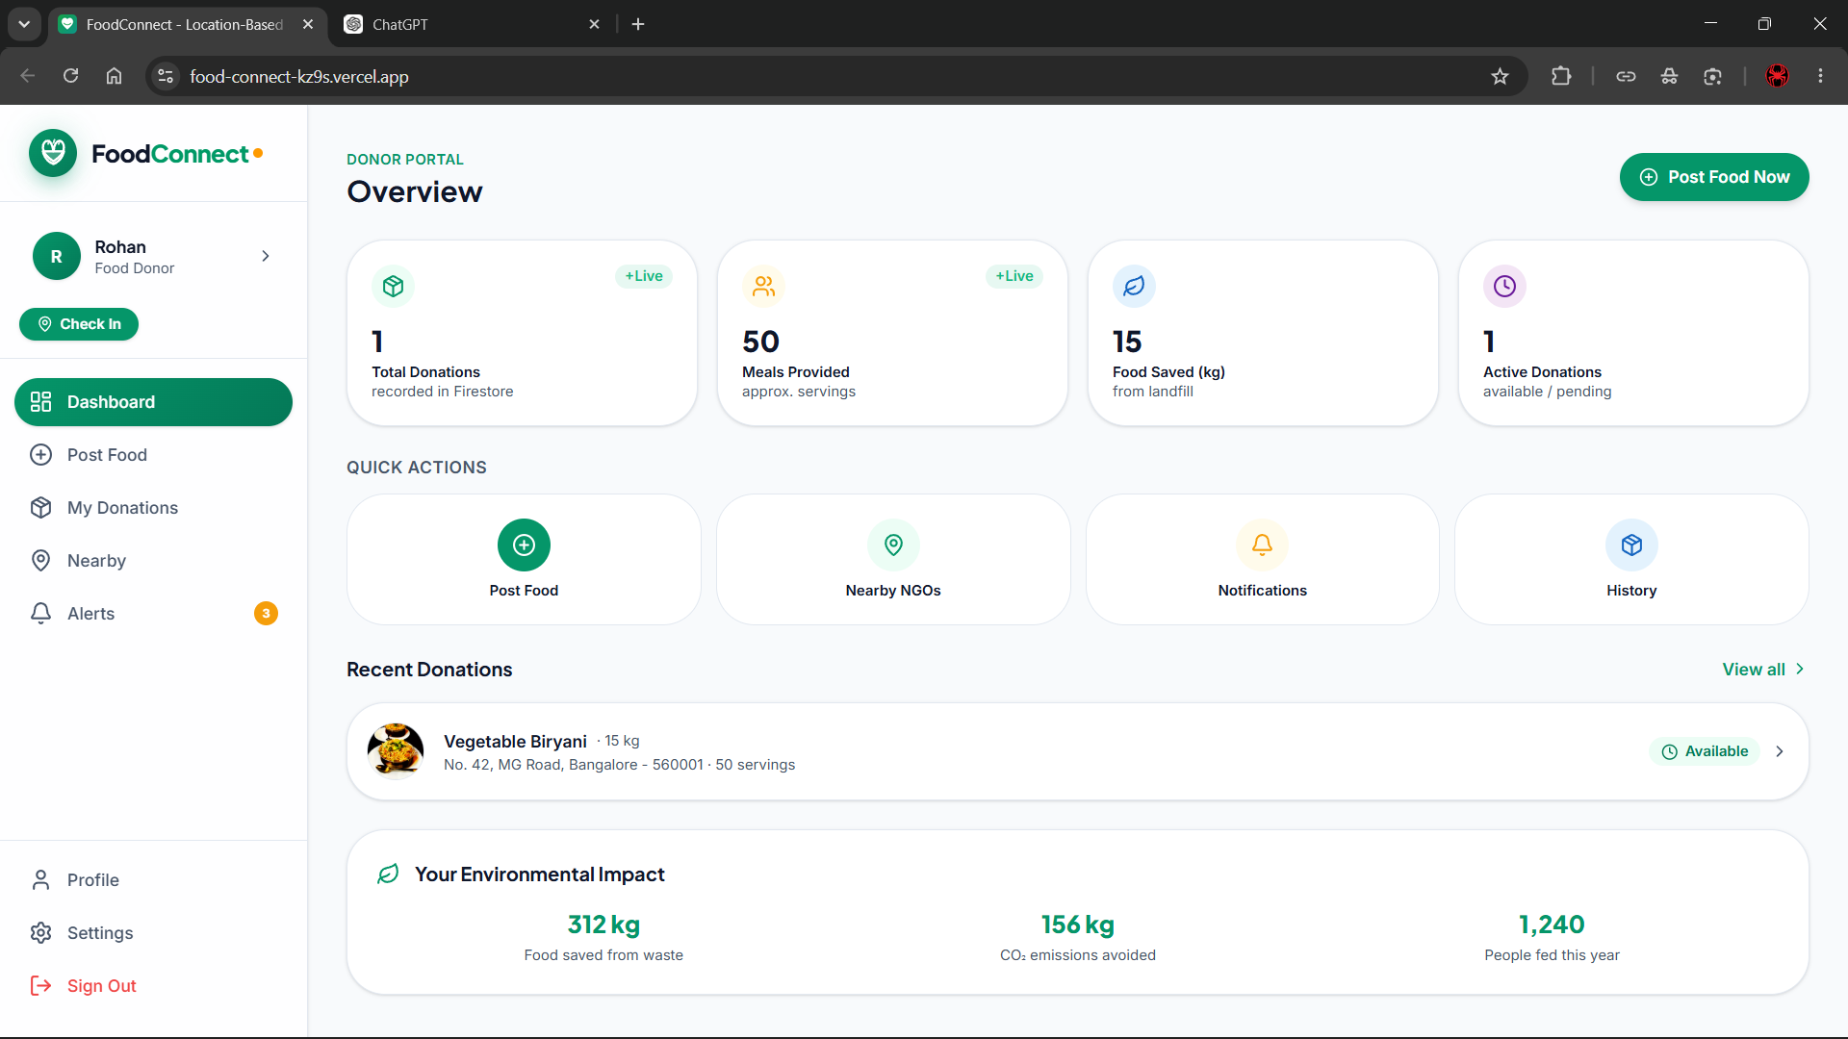
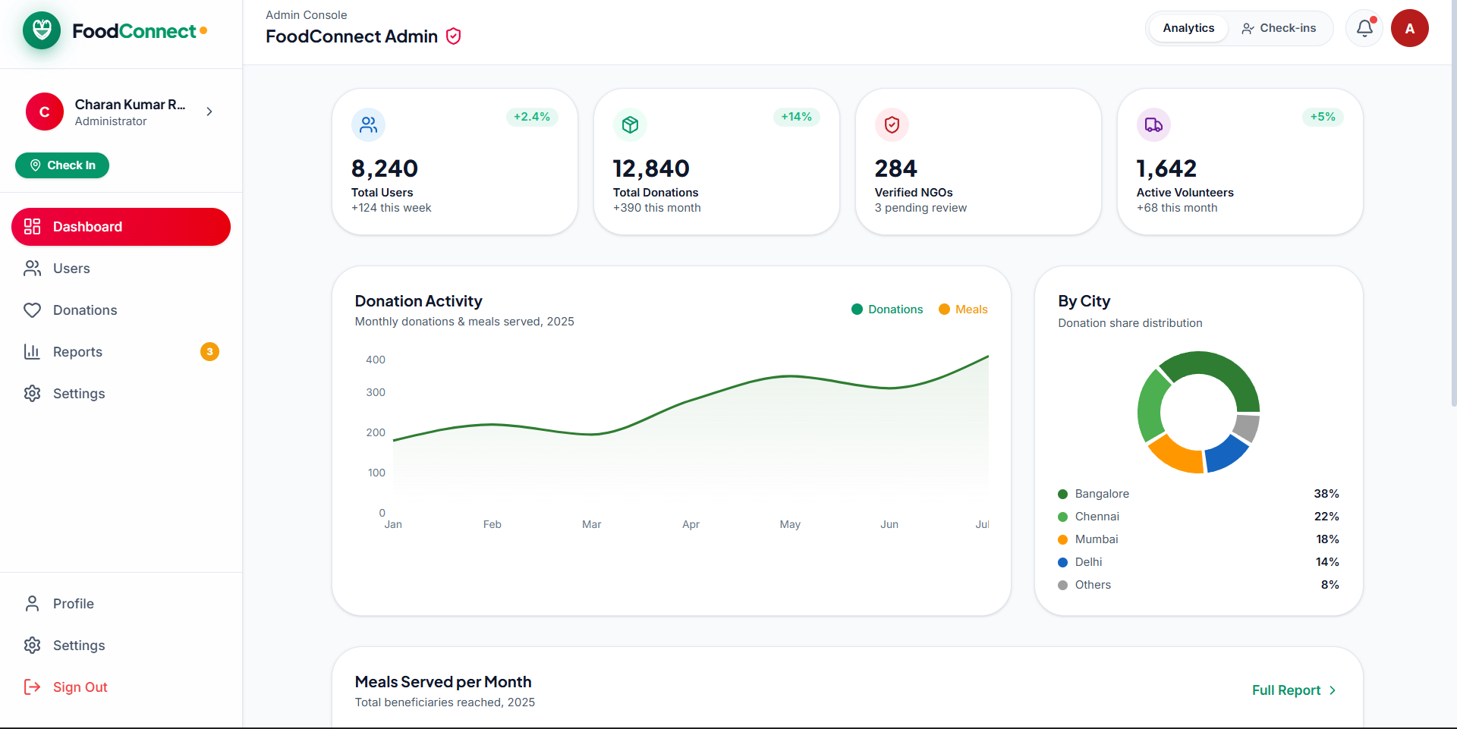
DASHBOARD

Slide 13
RESULTS & DISCUSSION
The platform provides a centralized system that connects food donors, NGOs, volunteers, and administrators, making the redistribution process more organized.
Donors can add extra food details, while NGOs can view available donations and submit requests based on their requirements.
The location-based matching helps identify nearby donors and volunteers, improving coordination and reducing unnecessary travel.
The system allows users and administrators to track donations, requests, volunteer assignments, and delivery status throughout the process.
The proposed system makes food redistribution more efficient, reduces edible food wastage, and helps ensure available food reaches people in need.
13

Slide 14
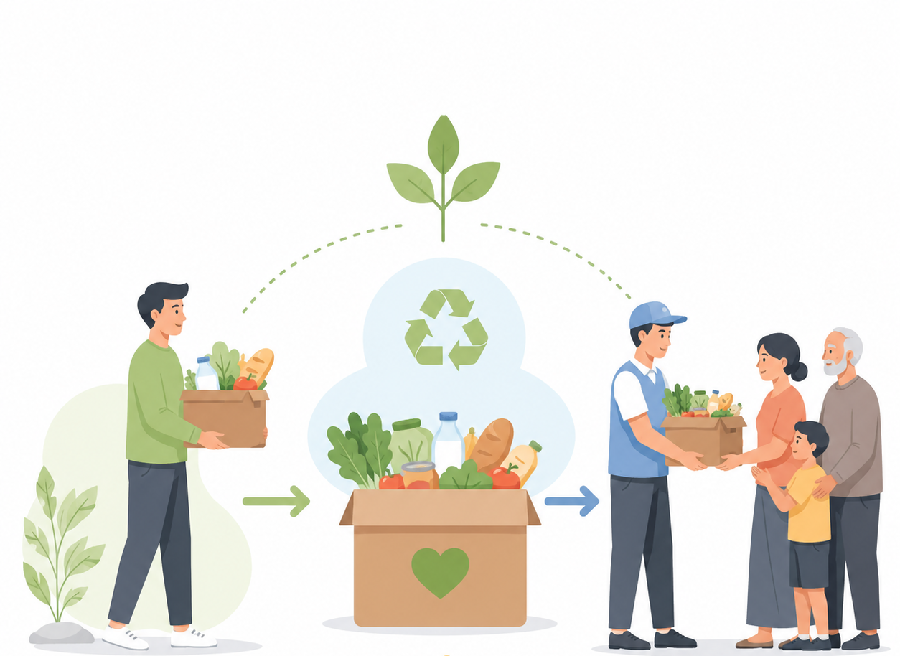
CONCLUSION
The proposed platform provides a centralized solution for managing and redistributing surplus food.
It connects donors, NGOs, volunteers, and administrators through a single system.
Location-based matching helps improve the efficiency of food collection and delivery.
The system provides better tracking and coordination throughout the donation process.
Overall, the platform aims to reduce food wastage and support sustainable food redistribution.
14

Slide 15
REFERENCES
R. Murthy, A. Atul, R. Sharma, A. Kaul, C. S. Nithya, and S. Himabindu, "Digital Stage for Surplus Food Redistribution: Undertaking Food Waste Through Online Donations," in Proc. IEEE SPARC, 2024.
C. Agmapisarn, P. Seetha, and P. Fakfare, "Optimizing Surplus Food Redistribution: Leveraging Digital Platforms to Advance Sustainable Consumption," Sustainable Development, vol. 33, 2025.
S. Bhardwaj, R. Markan, H. J. Kaur, S. Garg, and V. Kumari, "Designing a Location-Based Mobile Platform to Redirect Surplus Food from Households and Restaurants to the Needy," in Proc. IEEE 5th Int. Conf. on ICT in Business, Industry and Government (ICTBIG), 2025.
A. Karanth, A. K. Hemareddy, C. G. T., G. N., and H. V. Magadum, "A Web-Based Food Donation and Redistribution Platform for Efficient Surplus Food Management," International Journal of Computer Sciences and Engineering, vol. 13, no. 12, pp. 27–32, 2025.
C. den Broeder, L. Lazer, N. Gisasola-Maiztegi, B. Ruggiero, et al., "Challenges, Coping Mechanisms, and Solutions in Food Redistribution Efforts at the City Level," Discover Sustainability, vol. 7, Art. no. 123, 2026.
15

Slide 16
THANK YOU!

